Slide 1
Knowledge Inference
Entity Disambiguation
Label Propagation
Link Prediction

Slide 2
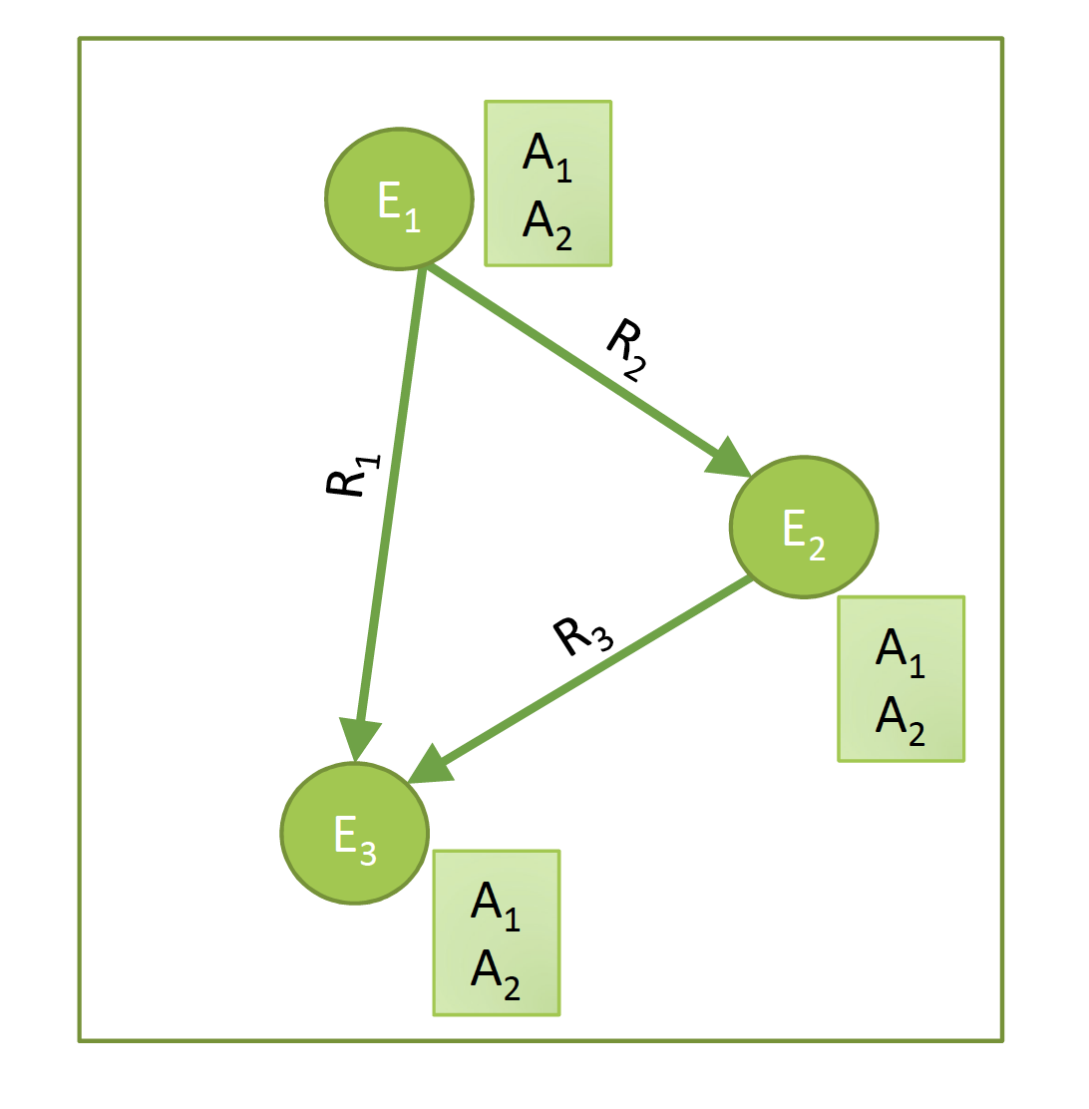
Basic Questions in Knowledge Inference
Who are the entities?
Entity Linking / Disambiguation
Data integration
What are their attributes?
Collective Classification
How are they related?
Link prediction
Notes:
Knowledge inference concerns a wide number of problems that have been studied in many different contexts. Some of the basic examples are:
Entity linking and disambiguation, which concerns the problem of identifying which entity names represent the same real-world entity, respective which entity is referred to in case of ambiguous entity names.
Schema integration, which concerns the problem which classes, attributes and relationships in one knowledge bases correspond to which in another one.
Collective classification, which concerns the problem of learning unknown attribute values from the available knowledge in a knowledge base.
Link prediction, which concerns the problem of learning unknown relationships from the available knowledge in a knowledge base.

Slide 3
1. Entity Disambiguation

Slide 4

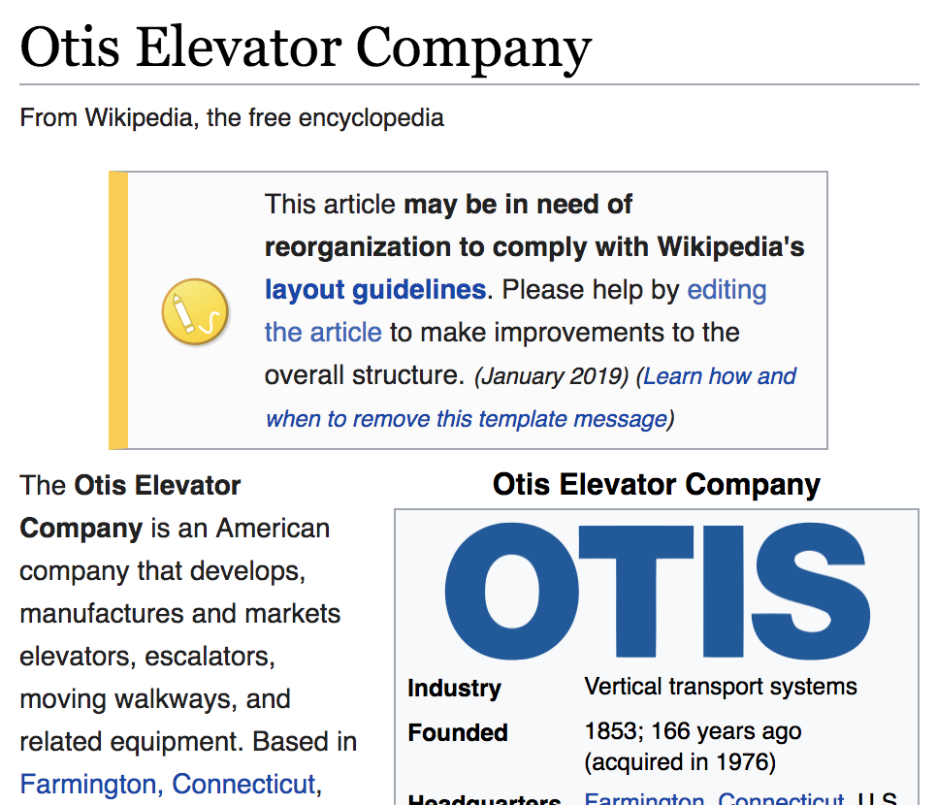
Entity Disambiguation
Task: Link a text mention in a document to an entry in a knowledge base (e.g. WikiPedia or WikiData)
Also called entity resolution and linking
Example: “Schindler is a Swiss industrial company. One of its main competitors is the American producer Otis.”
Notes:
Once entities in a text have been recognized, one would link them to their corresponding counter-parts in a knowledgebase. So entitiy disambiguation is a step that usually follows named entity recognition.

Slide 5
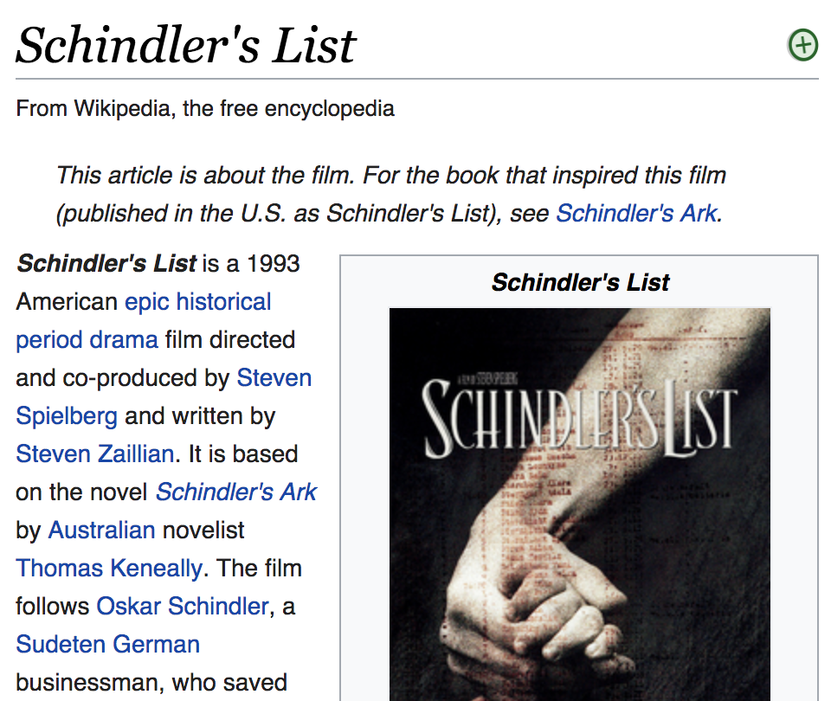
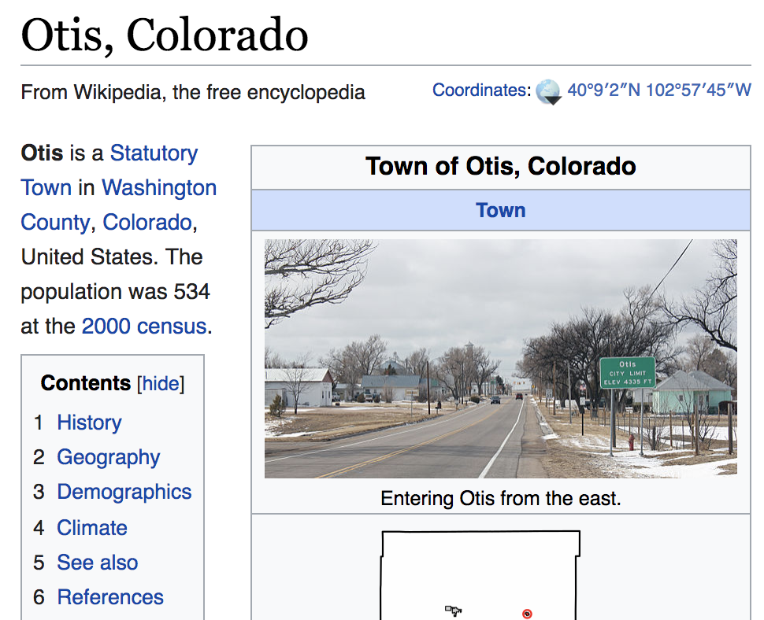
Challenge
Two problems
Homonyms: entities with the same name
Synonyms: different names for the same entity
Notes:
Entity disambiguation can however be quite challenging to the homonymy and synonymy problem. Handling these problems is essential for every text analytics tasks. Not being able to handle homonymy usually results in the introduction of noise into the results (poor precision) whereas not properly handling synonymy risks to miss relevant documents (poor recall).

Slide 6
Sources of Information
Local information: similarity of a text mention of the entity and the data in the knowledge base
Example: “Schindler” ≈ “Schindler’s list”
”Schindler” ≈ “Schindler Group”
Global information: coherence of different text mentions of potential entities within a document with respect to a knowledge base
→ entity graph
Notes:
For performing entity disambiguation one can exploit two different sources of information. On the one hand local information extracted from the text mention, or its vicinity, can be exploited. This can be used to compare the text mention and its features with the representation in the knowledge base, in order to obtain evidence which entitities in the knowledge base are potentially matched. A second source of information is the knowledge base itself, when multiple entities are mentioned in the same text. Since these entities from the same text are likely to be in some form of relationship among each other, it is likely that such relationships are also discovered in the knowledge base. This can help in entity disambiguation.

Slide 7
Entity Graph
“Schindler is a Swiss industrial company. One of its main competitors is the American producer Otis.”
m = “Schindler”
e = (c,m)
?
e’ = (c’’,m)
Schindler Holding
Schindler’s List
“Swiss”
Switzerland
Links in the knowledge base
American
Otis Elevator Company
Otis, Colorado
s = (c’,m’)
?
“American”
Possible interpretations of mention m
in the knowledge base by a concept c
m’ = “Otis”
Notes:
Here we illustrate the basic model of how a knowledge base can be employed for entity disambiguation:
m are text mentions of entities (extracted using NER)
For each mention there are candidates in KB; these can be identified using local information from the text mention
Each mention is a graph node; we can also associate a similarity measure to each node
Edges between mention-candidate pairs are included if a link exists in the KB among the respective candidates
Since the same text mention can relate to several candidates, the problem of entity disambiguation is to determine which among the multiple candidates is the most likely to be correct.

Slide 8
Coherence
How well does the choice of node s
support the presence of node e?
Other formulation: How relevant is node e for node s?
(as compared to e’, an alternative node)
e
e’
s
Notes:
To perform entity disambiguation, we pose the following question: given a node s in the entity graph, how well does it support the presence of another node e in the graph? Note, that s and e are concepts in the knowledge graph that correspond to the different mentions in the same text.
This question is actually related to a question that has been investigated in the context of personalized Web search: given a URL from the personal bookmark list of a user, how relevant is a page in the Web for this user. To answer this question a variation of the PageRank algorithm, which determines general relevance, has been proposed. It is called Personalized PageRank, which determines relevance with respect to a specific node in the graph.

Slide 9
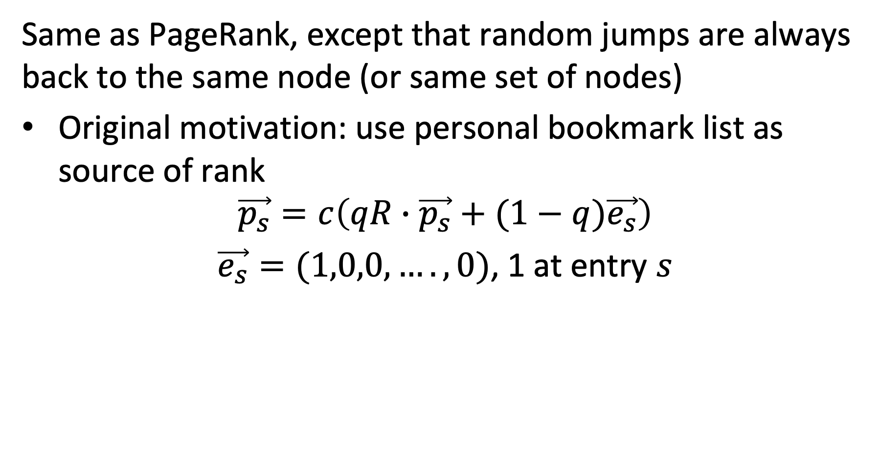
Personalized PageRank
Same as PageRank, except that random jumps are always back to the same node (or same set of nodes)
Original motivation: use personal bookmark list as source of rank
$$\vec{p_{s}}=c\left(qR∙\vec{p_{s}}+(1−q)\vec{e_{s}}\right)$$ $\vec{e_{s}}=(1,0,0,….,0)$, 1 at entry $s$
Notes:
Personalized PageRank works almost the same as the original PageRank. The difference is that random jumps are not performed uniformly random to any other node of the graph, but to a selected subset of nodes. In the case of Web search this subset would be the personal bookmark list, and by jumping back to this subset nodes from that list will have a large influence on the ranking of a page, such that nodes that are well connected to the bookmarks will receive more ranking value.

Slide 10
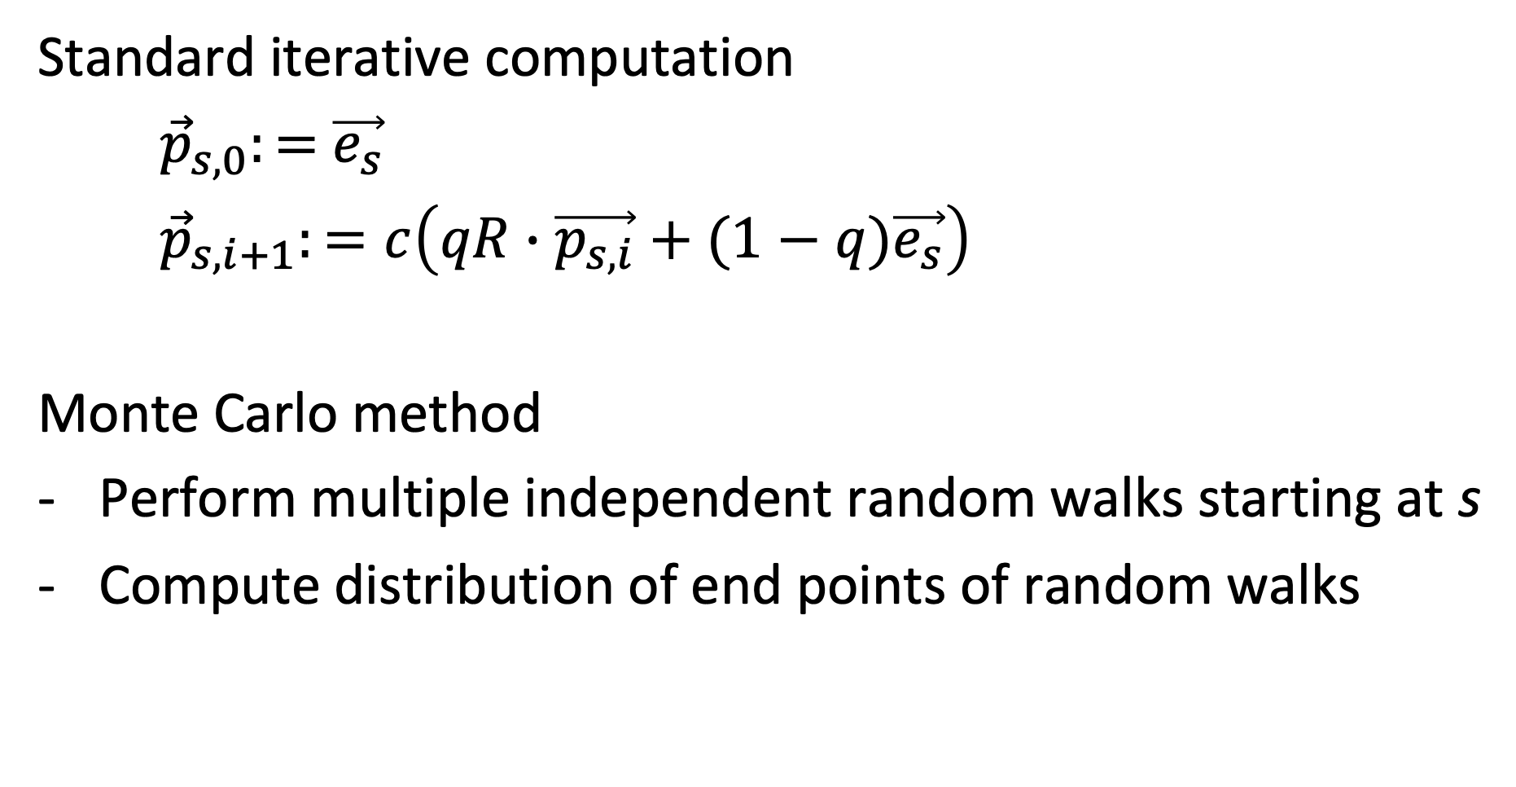
Computing PPR
Standard iterative computation
${\vec{p}}_{s,0}:=$ $\vec{e_{s}}$
${\vec{p}}_{s,i+1}:=c\left(qR∙\vec{p_{s,i}}+(1−q)\vec{e_{s}}\right)$
Monte Carlo method
Perform multiple independent random walks starting at s
Compute distribution of end points of random walks
Notes:
PPR can be computed either like standard PageRank, or using a Monte Carlo method, by starting random walks independently and aggregate the distribution of the end points of those walks.

Slide 11
PPR on Entity Graph
?
Source node s supports concept c
e = (c,m)
e’ = (c’’,m)
PPR_{s}(e) = high
PPR_{s}(.) = 0
e
PPR_{s}(.) = medium
s
PPR_{s}(.) = medium
PPR_{s}(s) = high
PPR_{s}(.) = 0
Notes:
Now applying PPR, by considering a source node s as the selected subset of preferred nodes, will generate a distribution of ranking values for all other nodes. Nodes that are well connected to s will receive higher ranking values. Intuitively it is clear, that in our example node e will be receive higher ranking when starting from s, and this be probably the preferred interpretation for the entity.

Slide 12
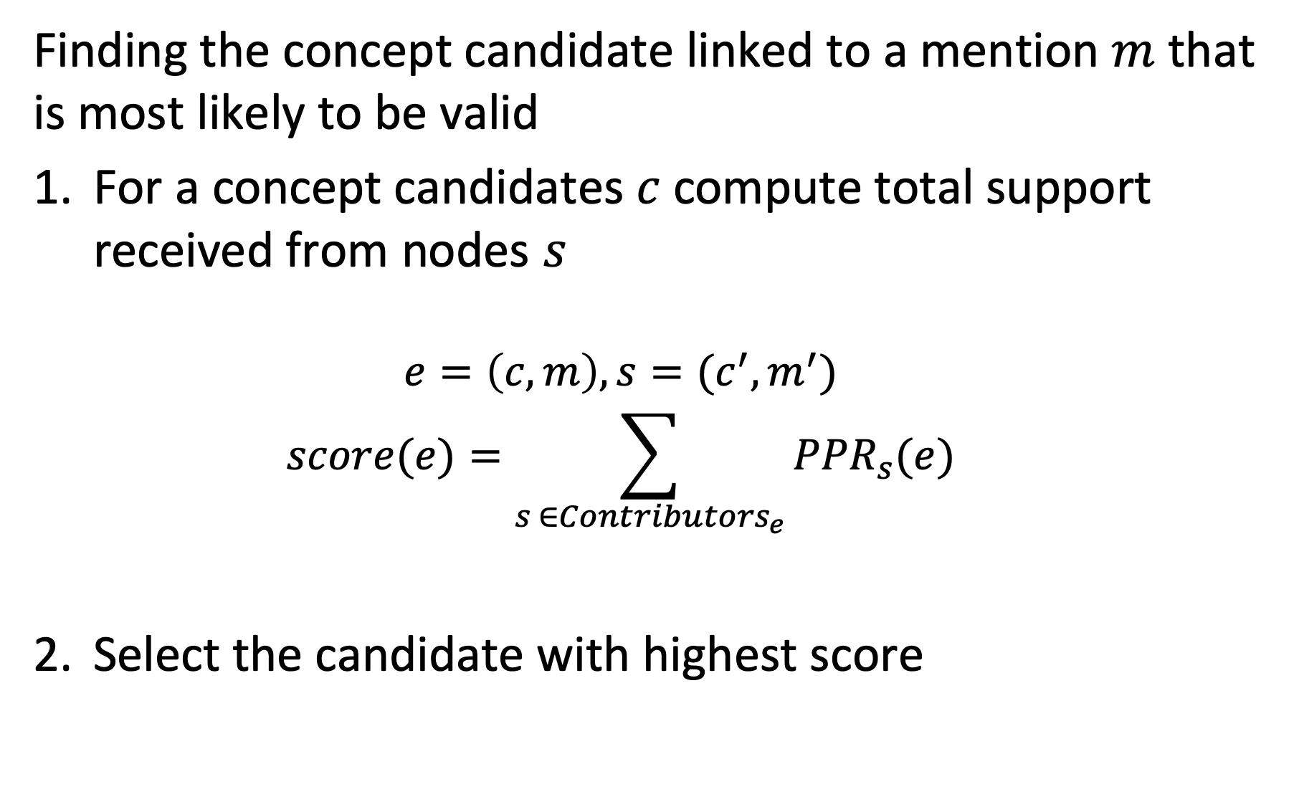
Scoring
Finding the concept candidate linked to a mention $m$ that is most likely to be valid
For a concept candidates $c$compute total support received from nodes $s$
$$e=\left(c,m\right), s=(c^{′},m^{′})$$
$$score(e)=\sum_{s ∈{Contributors}_{e}}{{PPR}_{s}(e)}$$
Select the candidate with highest score
Notes:
The procedure for selecting the best concept candidate for a text mention is straightforward. One computes the total support that the candidate receives from other nodes s, by computing the PPR of e with the source node s a selected node. Which source nodes s are contributing to this computation we need still to determine. At the end the candidate with the highest score is selected.

Slide 13
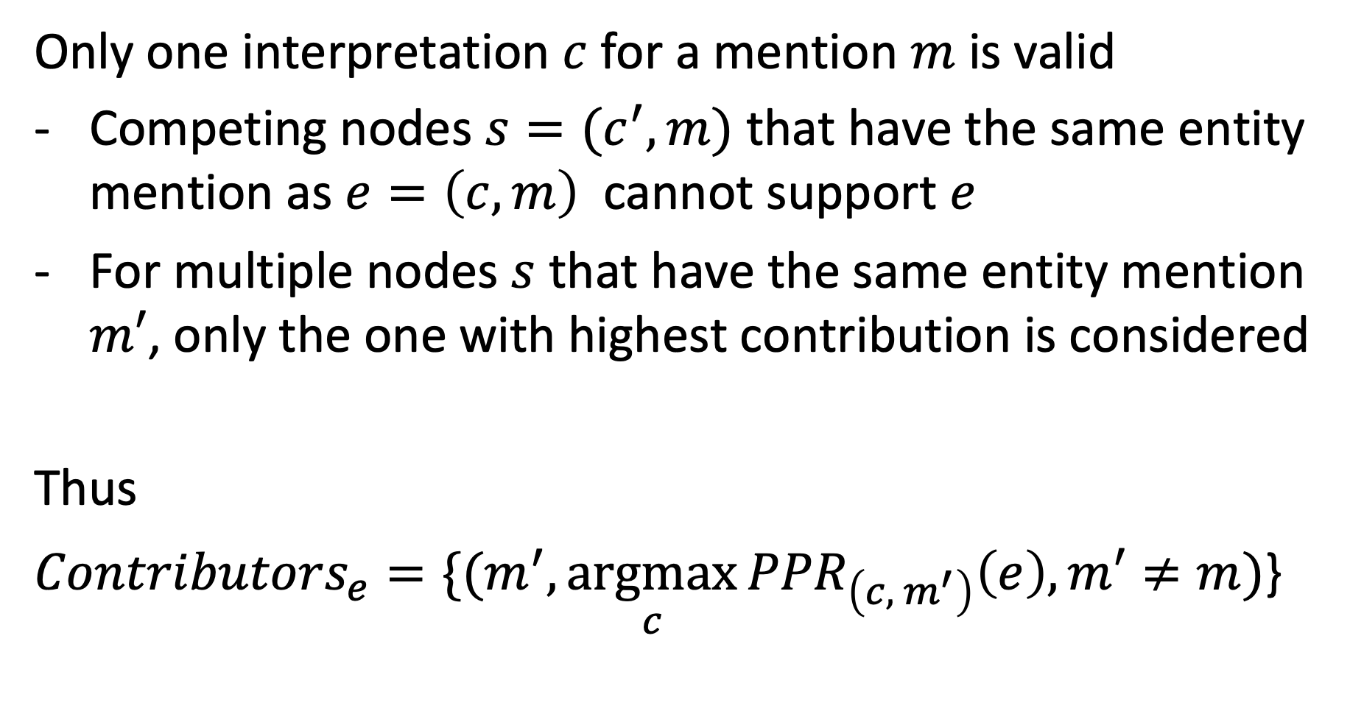
Contributing Nodes
Only one interpretation $c$ for a mention $m$ is valid
Competing nodes $s=(c^{′},m)$ that have the same entity mention as $e=\left(c,m\right)$ cannot support $e$
For multiple nodes $s$ that have the same entity mention $m′$, only the one with highest contribution is considered
Thus
${Contributors}_{e}={\{(m}^{′},\underset{c}{argmax}{{PPR}_{\left(c, { m}^{′}\right)}\left(e\right),m′≠m)}$}
Notes:
Not every node should contribute as source node for a mention m, if we assume that only one interpretation can be correct. First, we exclude nodes that are “competing” for the interpretation of the text mention. Second for multiple nodes related to the some other entity mention, we select only the contribution of the one that has the highest value. In this way we favor a unique interpretation for mentions.

Slide 14
Example: Contributors_{e}
PPR_{s}(e) = high
PPR_{s}(.) = 0
Competing node
e
PPR_{s}(.) = medium
s
PPR_{s}(.) = medium
Lower contribution
PPR_{s}(s) = high
PPR_{s}(.) = 0

Slide 15
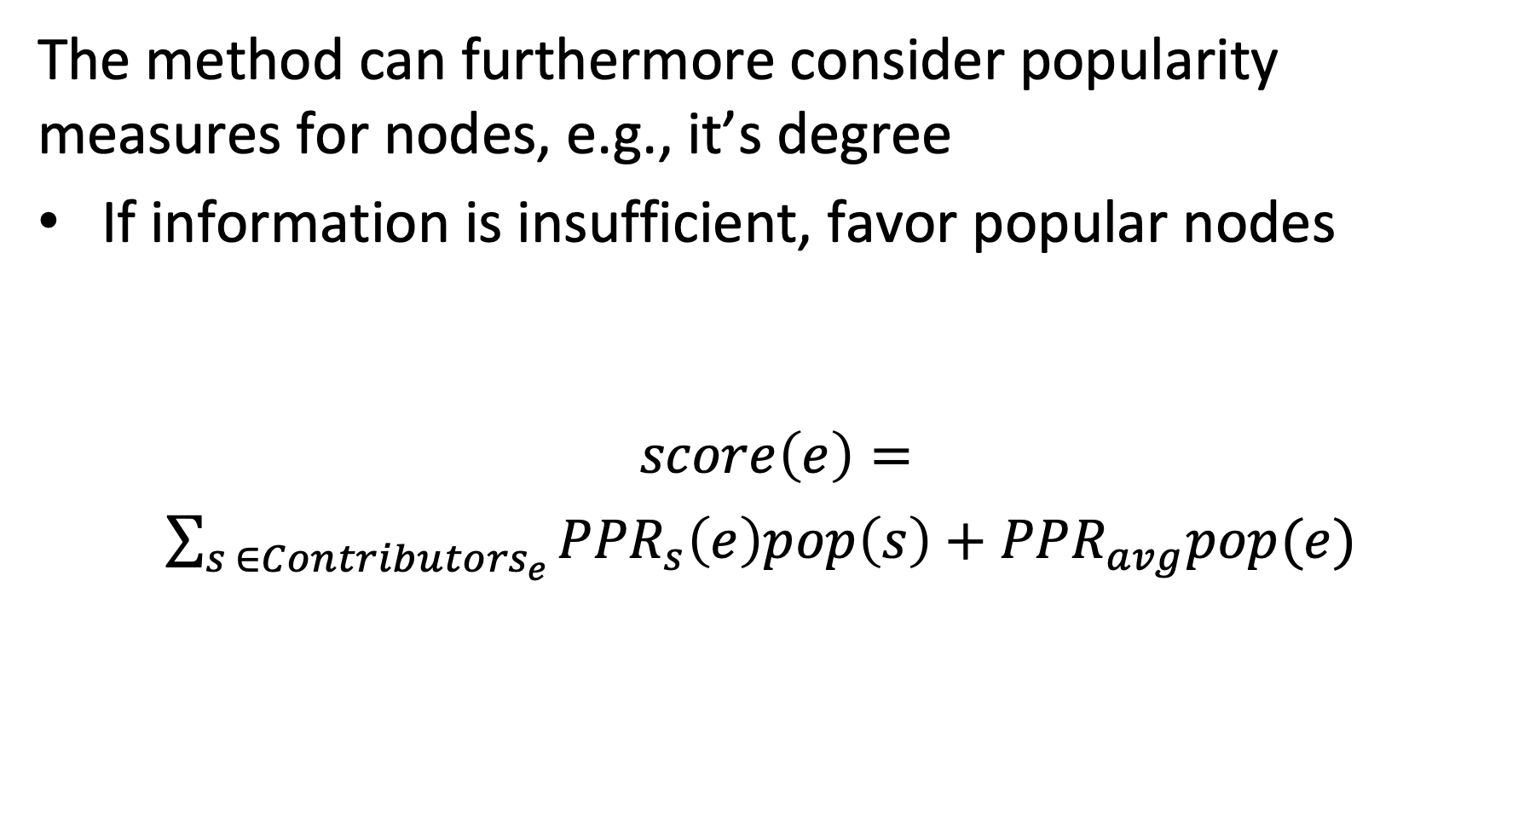
Considering Popularity
The method can furthermore consider popularity measures for nodes, e.g., it’s degree
If information is insufficient, favor popular nodes
$$score\left(e\right)=$$ $\sum_{s ∈{Contributors}_{e}}{{PPR}_{s}\left(e\right)pop\left(s\right)}+{PPR}_{avg}pop(e)$
Promotes contributions from popular nodes
Promotes popular nodes
Notes:
To further improve the method, one can add a general popularity measure to weight the contributions of source nodes.This will favor popular nodes, which is beneficial if little information is available for disambiguation. Then it is better to choose a popular candidate since chances that this is correct are higher. One of possible choice of a popularity score could be the number of links a node has in the knowledge base.

Slide 16
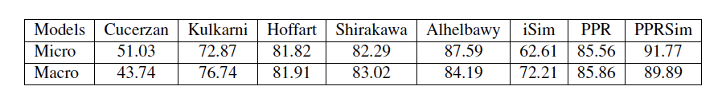
Some Results
Without popularity
Other methods
Uses pageRank
With popularity
Micro = fraction of correctly disambiguated entities
Macro = proportion of textual mentions, correctly disambiguated per entity, averaged over all entities
Notes:
Experimental results show that the method works relatively well, with around 90% of entities that are correctly disambiguated. One can observe that the use of popularity helps to slightly improve the results.

Slide 17
Which is false?
Entity disambiguation addresses the problem of synonyms
Named entity recognition addresses the problem of synonyms
Entity disambiguation addresses the problem of entity classification
Named entity recognition addresses the problem of entity classification

Slide 18
Which nodes cannot contribute to the score of a mention linked to a concept?
Other concepts linked to the same mention
Concepts that have in the knowledge graph no outgoing links
Concepts that have in the knowledge graph no incoming links
Concepts with low popularity

Slide 19
2. Label Propagation

Slide 20
Inferring Attribute Values
Example problem: Which users on Twitter have positive or negative emotion towards a topic?
Users are nodes in a graph (follower network)
Emotion is an attribute of the node
Potential source of information in the case of Twitter
Emoticons in tweets: indicate stance of user towards the topic
Only a (small) fraction of the users is using emoticons
Notes:
A second inference task in knowledge bases, after entities have been disambiguated, is to assign to the entities correct attribute values. For discrete attributes this problem can be understood as a classification problem. This question has, for example, been studied for classifying users in a social network with respect to their stance or emotion towards a specific topic.
In the case of emotion analysis there exists typically indications of emotions, e.g., in the form of the use of emoticons or specific hashtags. However, only few users are using those.

Slide 21


Propagating Attribute Values
Assumption: nodes that are connected by an edge, have a higher propensity of sharing the attribute of interest
Twitter users following each other, are more likely to share the same emotion towards a topic
?
Probably:
Notes:
In many cases nodes that are connected by edges in a knowledge graph or as well in a social network, share properties. In social networks this is quite apparent. People that are connected through social links (e..g follower, friend, retweet, reply etc) are in general more likely to share opinions than those that are not. Is it possible to exploit this property to predict the attributes (respectively class lables) for those users that have none?

Slide 22
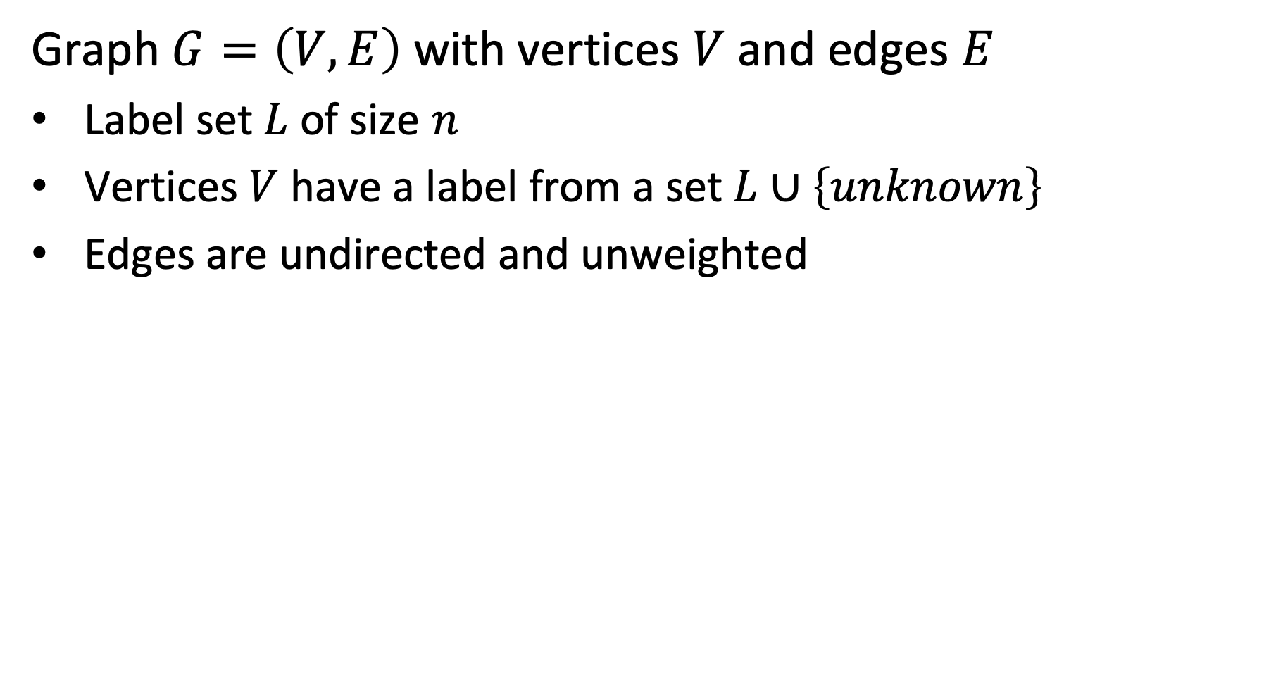
Model
Graph $G=\left(V,E\right)$ with vertices $V$ and edges $E$
Label set $L$ of size $n$
Vertices $V$ have a label from a set $L∪\left\{unknown\right\}$
Edges are undirected and unweighted
+
-
-
+
u
Labels +, -, u
-
+
Notes:
We consider the following model. A graph with vertices that can have either a label from a set L, or a label unknown. The edges are all undirected and unweighted. The model and approach can be extended for directed graphs with weighted edges.
We associate with vertices probability distributions that represent our knowledge about the assignment of a label. For all vertices we will compute an inferred probability distribution.

Slide 23
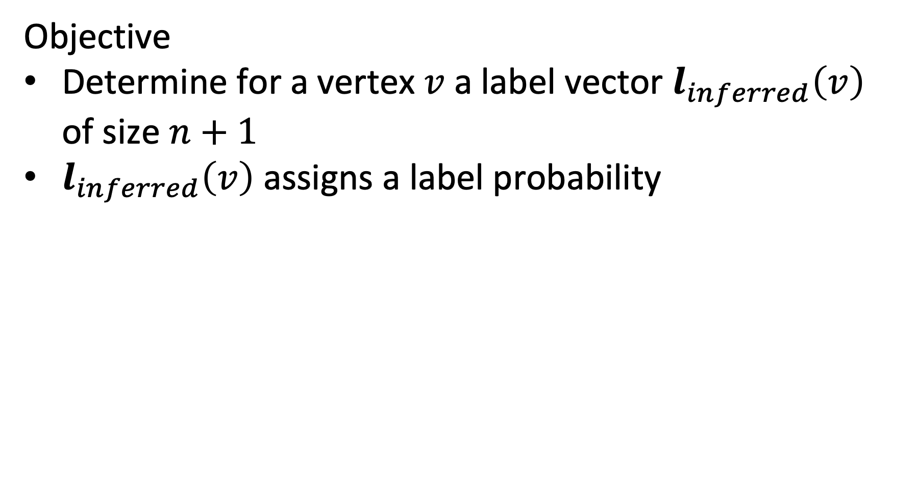
Optimization Objective
Objective
Determine for a vertex $v$ a label vector $l_{inferred}\left(v\right)$ of size $n+1$
$l_{inferred}\left(v\right)$ assigns a label probability
(1, 0 , 0)
(0, 1 , 0)
(0, 1 , 0)
+
-
-
(1, 0 , 0)
+
u
(0, 0, 1)
Labels +, -, u
-
+
(0, 1 , 0)
(1, 0 , 0)

Slide 24
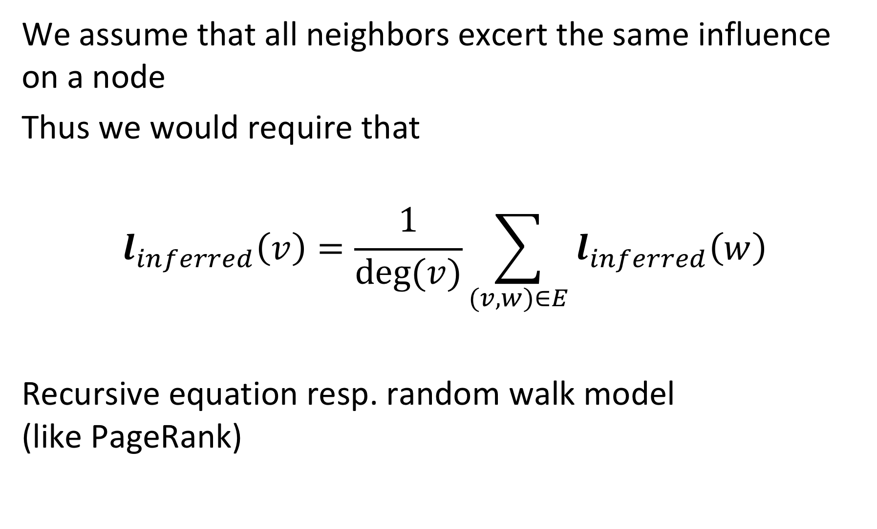
Label Inference
We assume that all neighbors excert the same influence on a node
Thus we would require that
$$l_{inferred}\left(v\right)=\frac{1}{deg⁡(v)}\sum_{(v,w)∈E}{l_{inferred}\left(w\right)}$$
Recursive equation resp. random walk model (like PageRank)
Notes:
In this model we assume that all neighbors of a node in the graph are equally influencing it. Thus, we can compute its expected label distribution by averaging the distributions of the neighbors. The resulting equation is analogous to the formulation of the PageRank model. Thus the Label Inference can be interpreted as a random walk model.
The model can be extended to weighted graphs, in which case the edge weight would be considered in the aggregation of the distributions of the neighboring vertices.

Slide 25
Example
(1, 0 , 0)
(0, 1 , 0)
(0, 1 , 0)
+
-
-
(1, 0 , 0)
+
u
(0, 0, 1)
Labels +, -, u
-
+
(0, 1 , 0)
(1, 0 , 0)
l_{inferred}=1/4 ((0, 1 , 0) + (0, 1 , 0) + (0, 1 , 0) + (1, 0 , 0)) = (1/4, ¾, 0)

Slide 26
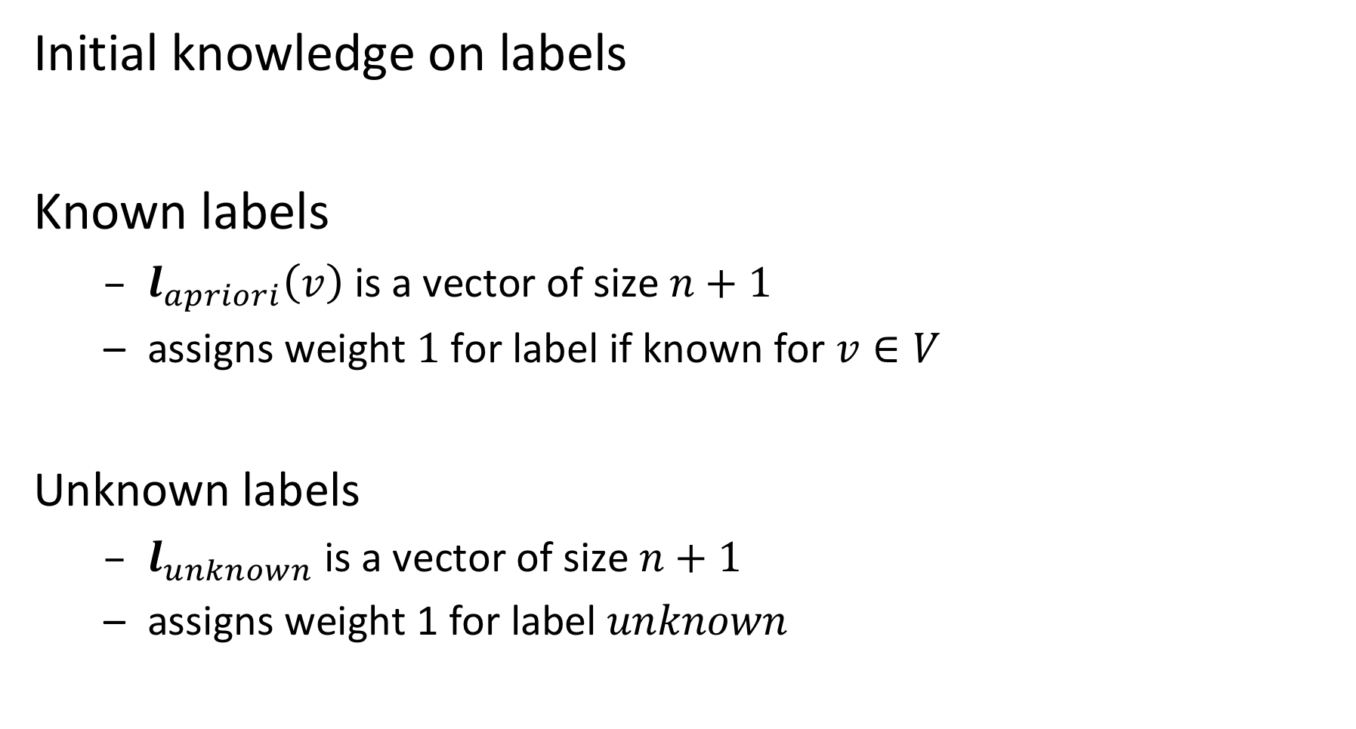
Injecting Pre-existing Knowledge
Initial knowledge on labels
Known labels
$l_{apriori}\left(v\right)$ is a vector of size $n+1$
assigns weight $1$ for label if known for $v∈V$
Unknown labels
$l_{unknown}$ is a vector of size $n+1$
assigns weight 1 for label $unknown$
Notes:
For some vertices we have an apriori assignment of labels (these are the vertices for which the label is known). For vertices that have no apriori label assigned we have a vector to represent the unknown state. Note that the apriori distribution can also be a true probability distribution, if we are initially not sure about the label, but have some partial knowledge.

Slide 27
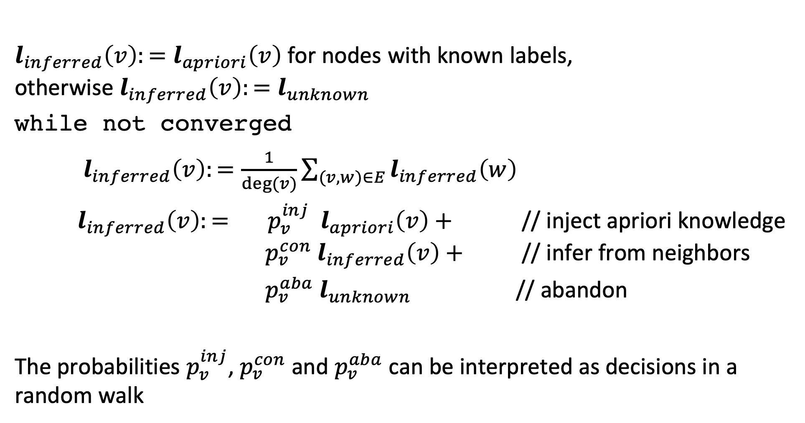
Label Propagation Algorithm
$l_{inferred}\left(v\right):=l_{apriori}\left(v\right)$ for nodes with known labels, otherwise ${l_{inferred}\left(v\right):=l}_{unknown}$
while not converged
$l_{inferred}\left(v\right):=\frac{1}{deg⁡(v)}\sum_{(v,w)∈E}{l_{inferred}\left(w\right)}$
$l_{inferred}\left(v\right):= p_{v}^{inj}{ l}_{apriori}\left(v\right)+$ // inject apriori knowledge $p_{v}^{con}{ l}_{inferred}\left(v\right)+$ // infer from neighbors
$p_{v}^{aba}{ l}_{unknown}$ // abandon
The probabilities $p_{v}^{inj}$, $p_{v}^{con}$ and $p_{v}^{aba}$ can be interpreted as decisions in a random walk
Notes:
The full label propagation model adds additional aspects to the propagation of labels to neighbors. The probabilities should be understood as the decisions that a random walker can take to find a neighboring node from which to learn the label.
For vertices with apriori labels, at every step the apriori distribution is injected with a certain probability $p_{v}^{inj}$ that depends on the vertex
For all vertices the propagation process (random walk) can also be abandoned with a certain probability $p_{v}^{aba}$. In that case the becomes unknown.
The propagation of the label distribution to neighbors occurs then with a (remaining) probability of $p_{v}^{con}$.
As in PageRank the process is iterated till convergence occurs.

Slide 28
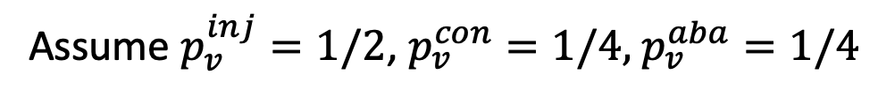
Example
Assume $p_{v}^{inj}=1/2$, $p_{v}^{con}=1/4,$ $p_{v}^{aba}=1/4$
(1, 0 , 0)
(0, 1 , 0)
(0, 1 , 0)
+
-
-
(1, 0 , 0)
+
u
(0, 0, 1)
Labels +, -, u
-
+
(0, 1 , 0)
(1, 0 , 0)
l_{inferred} = ½ (0, 0, 1) + ¼ (¼, ¾, 0) + ¼ (0, 0, 1) = (1/16, 3/16, 3/4)

Slide 29
Determining the Probabilities
The choice of the transition probabilities results in different variants of label propagation algorithms
Possible considerations
pre-labelled nodes should have higher influence on neighbors than initially unlabeled nodes
well-connected nodes should have higher influence that sparsely connected nodes

Slide 30
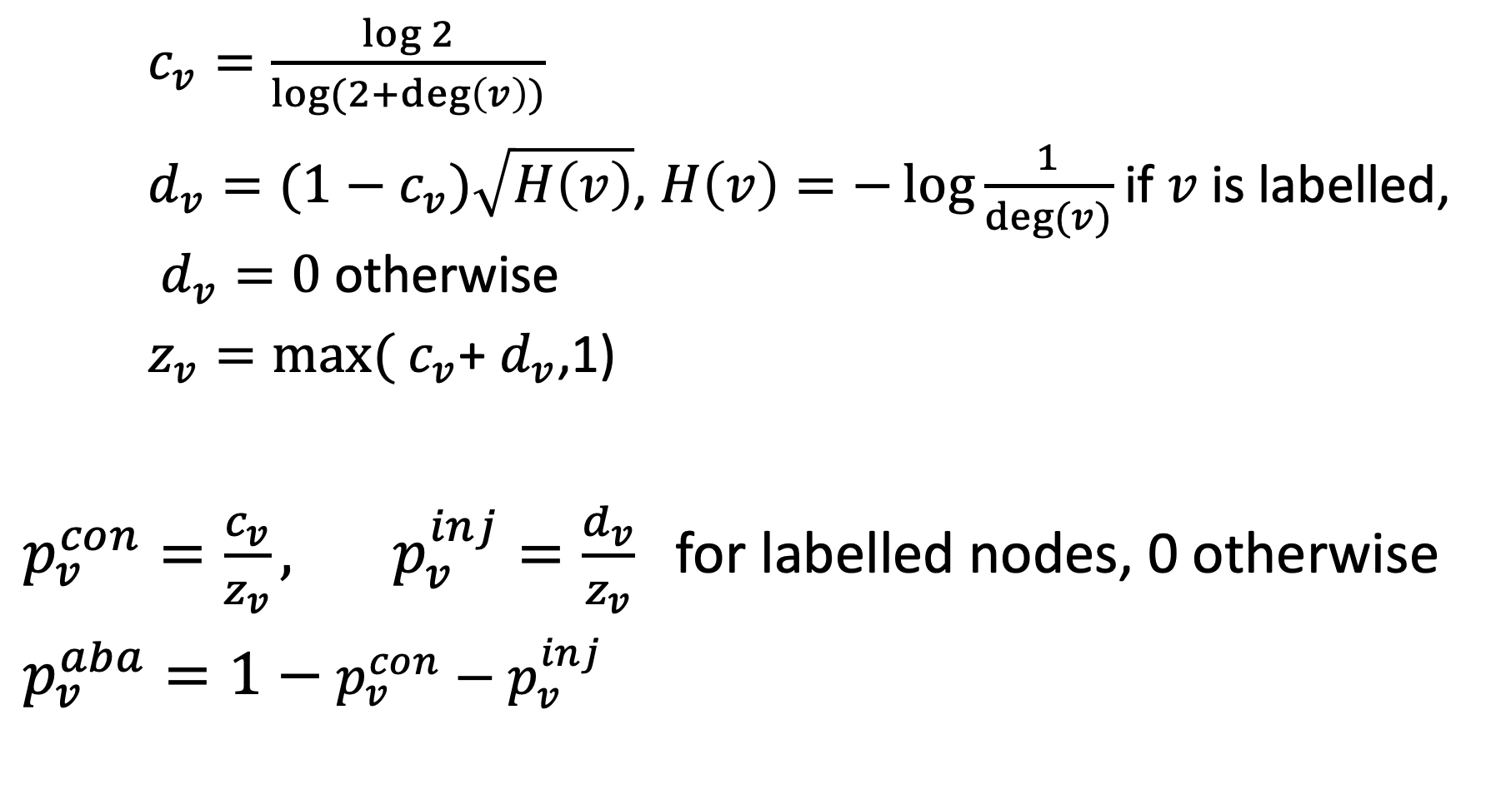
Example Model
$c_{v}=\frac{\log{2}}{\log{(2+\deg\left(v\right))}}$
$d_{v}=(1−c_{v})\sqrt{H\left(v\right)}$, $H\left(v\right)=−\log{\frac{1}{deg⁡(v)}}$ if $v$ is labelled, $d_{v}=0$ otherwise
$z_{v}=\max{(}$ $c_{v}$+ $d_{v}$,1)
$p_{v}^{con}=\frac{c_{v}}{z_{v}}, p_{v}^{inj}=\frac{d_{v}}{z_{v}}$for labelled nodes, 0 otherwise
$p_{v}^{aba}=1−$ $p_{v}^{con}−p_{v}^{inj}$
Notes:
The transition probabilities depend on the properties of the vertices. In our model, the only relevant property is its degree.
In a more general model with edge weights the probabilities would depend on the distribution of edge weights of the edges connected to the vertice (Fan-out entropy heuristics)

Slide 31
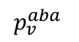
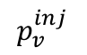
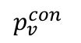
Behavior of Probabilities: Labelled Nodes
Injection probability increases with the degree of the nodes, while continuation probability decreases
Abandoning probability positive for only very low degree nodes (d = 1,2)
$$p_{v}^{con}$$
$$p_{v}^{inj}$$
$$p_{v}^{aba}$$
Notes:
For labelled nodes the injection probability increases with the degree. Thus, well connected pre-labelled nodes have a lot of influence.

Slide 32
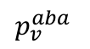
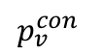
Behavior of Probabilities: Unlabelled Nodes
Abandon probability increases with degree
Prevents algorithm from propagating information through unlabeled, high-degree nodes
$$p_{v}^{con}$$
$$p_{v}^{aba}$$
Notes:
For unlabeled nodes the behavior the abandon probability increases with the degree. Thus, high degree nodes have less influence.

Slide 33
Extensions
Label Propagation can be extended to
A priori knowledge given as probability distribution
Graphs with weighted edges
Directed Graphs
Alternative algorithm: MAD (modified adsorption)
Formulates an optimization problem and solves it directly
Slightly better performance in practice

Slide 34
Discussion
Label propagation is an example of a semi-supervised learning algorithm
Exploit partial labelling
Useful in cases where labels are sparse or labels can produced only for special cases using heuristics or background knowledge
Require that relationships among entities and their labels are correlated by some underlying principle

Slide 35
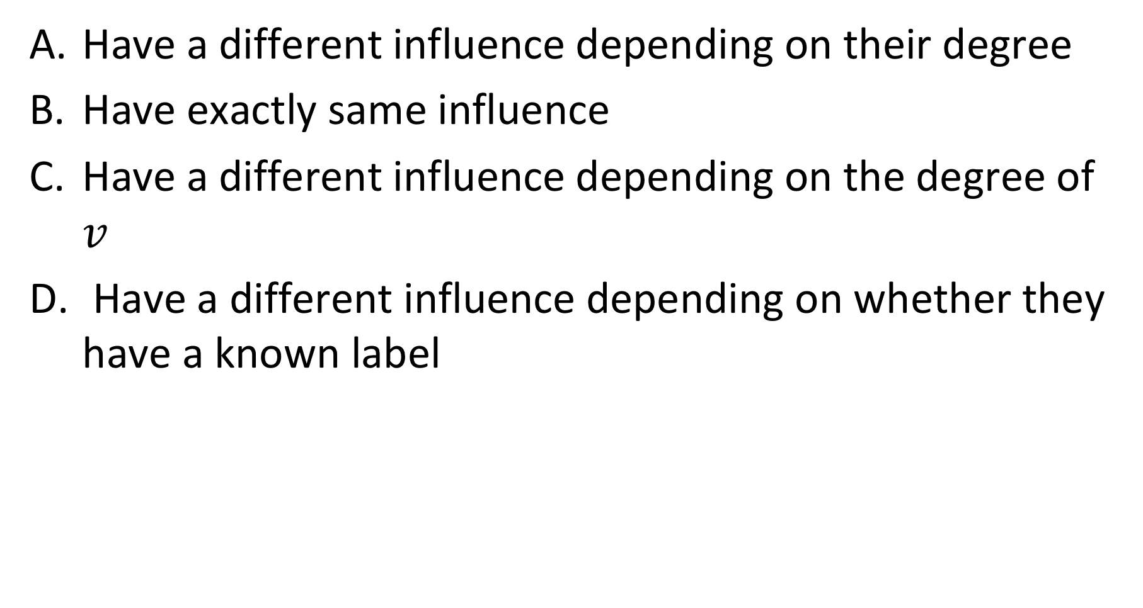
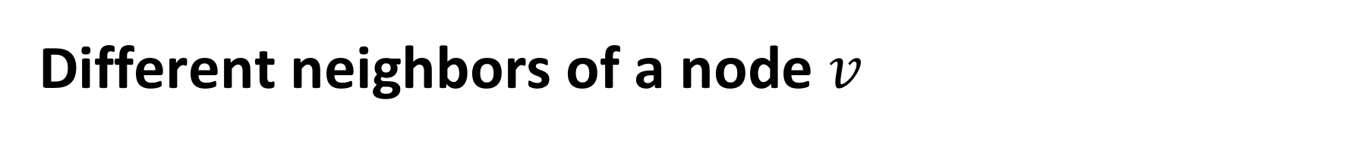
Different neighbors of a node $v$
Have a different influence depending on their degree
Have exactly same influence
Have a different influence depending on the degree of $v$
Have a different influence depending on whether they have a known label

Slide 36

The probabilities $p_{v}^{inj}$, $p_{v}^{con}$ and $p_{v}^{aba}$ depend on
The node degree
The pre-existing knowledge on labels
On both node degree and pre-existing knowledge
On further factors

Slide 37
3. Link Prediction

Slide 38
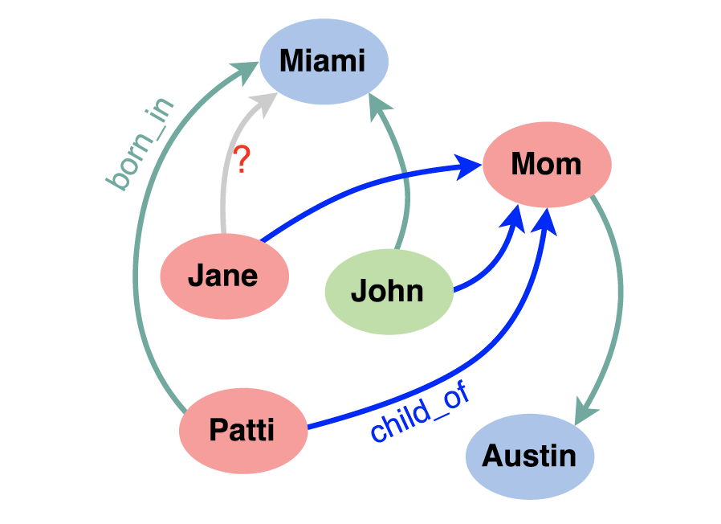
Knowledge Base Completion
Large knowledge bases are usually incomplete
DBPedia: 60% of persons miss place of birth
FreeBase: 71% of persons miss place of birth etc.
Try to predict missing links from existing data
Jane born in Miami?
Notes:
In general, knowledge bases are incomplete. Thus there is a significant interest in completing in particular the relationships among entities. To do so one might exploit “patterns” that entities and relationships follow, and generalize them.

Slide 39
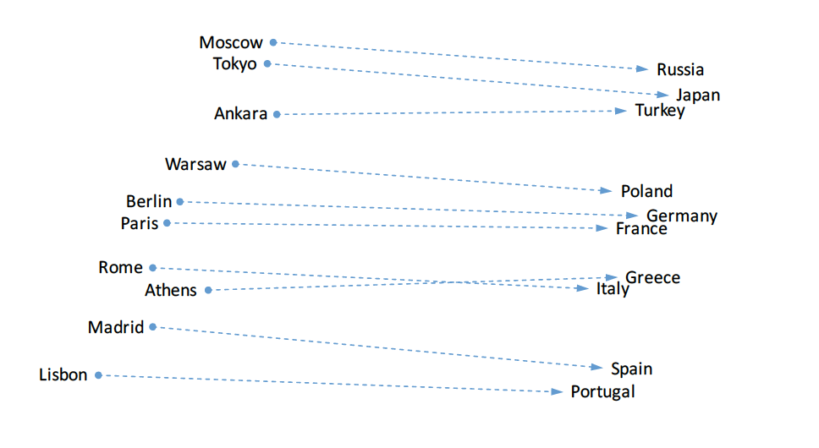
Observation on Word Embeddings
Notes:
In order to tackle this problem, we come back to an observation that we had made for word embeddings. We found that (in some cases) relationships seem to be encoded as linear transformations.

Slide 40
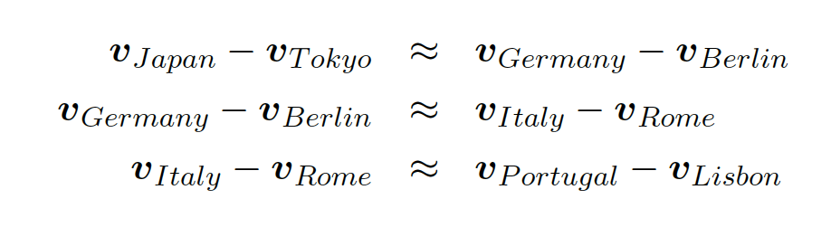
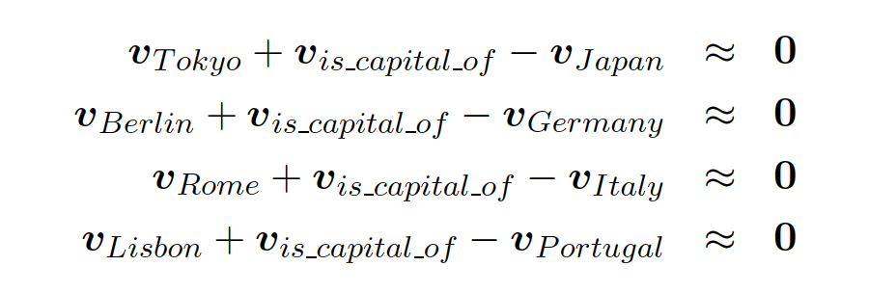
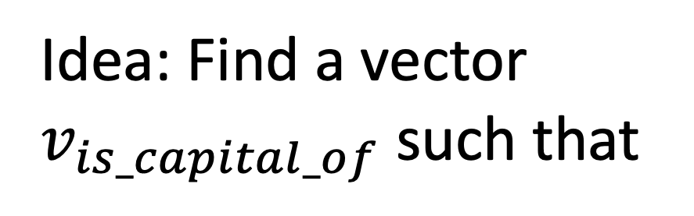
Relations in Word Embeddings
Idea: Find a vector
$v_{is_capital_of}$ such that
Relations are also represented as embedding vectors!
Notes:
This observation can be formally described in two different ways. We could say, that the differences of entity vectors that are in a relationship should result in similar values. Alternatively, we sould also say, that there must be some vector that represents the relationship and that the sum of this vector with the difference vector of the entities should be approximately zero. This second formulation of the properties gives rise to an idea of how link prediction could be performed using and embedding technique.

Slide 41
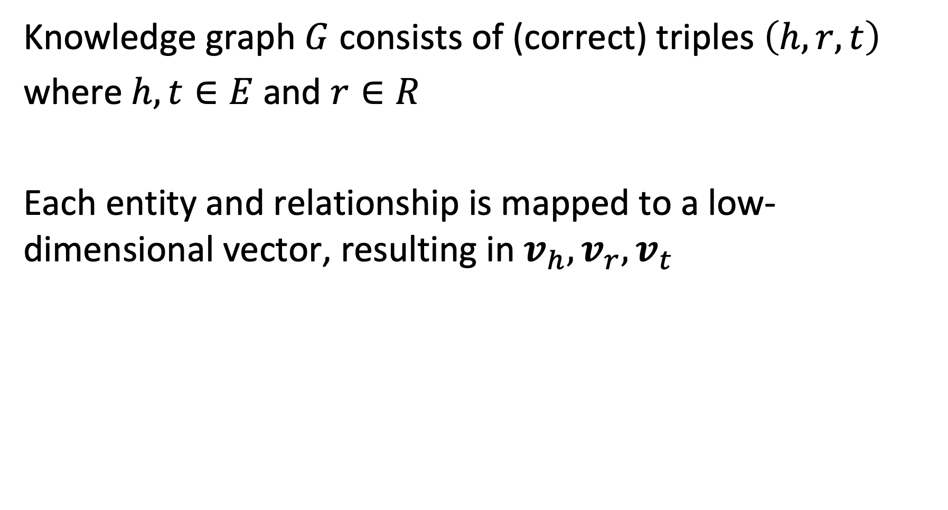
Model
Knowledge graph $G$ consists of (correct) triples $\left(h,r,t\right)$
where $h,t∈E$ and $r∈R$
Each entity and relationship is mapped to a low-dimensional vector, resulting in $v_{h}, v_{r},v_{t}$
Notes:
To formulate the model we assume that we have a knowledge graph consisting of triples $\left(h,r,t\right)$. $h$ indicates the term “head” and $t$ the term “tail”.

Slide 42
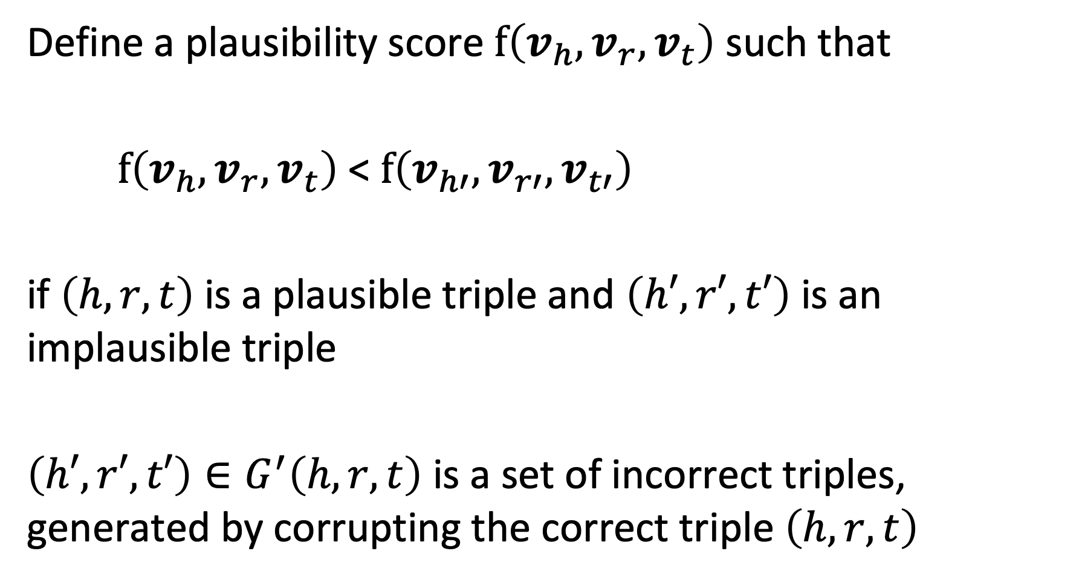
Plausibility Score
Define a plausibility score $f\left(v_{h}, v_{r},v_{t}\right)$ such that
$f\left(v_{h}, v_{r},v_{t}\right)$ < $f\left(v_{h′}, v_{r′},v_{t′}\right)$
if $\left(h,r,t\right)$ is a plausible triple and $\left(h′,r′,t′\right)$ is an implausible triple
$\left(h′,r′,t′\right)∈G^{′}\left(h,r,t\right)$ is a set of incorrect triples, generated by corrupting the correct triple $\left(h,r,t\right)$
Notes:
Then we introduce a function that measure how plausible a triple is (we can think of it as a probability). The plausibility score should return lower values for plausible tuples and higher ones for implausible ones.

Slide 43
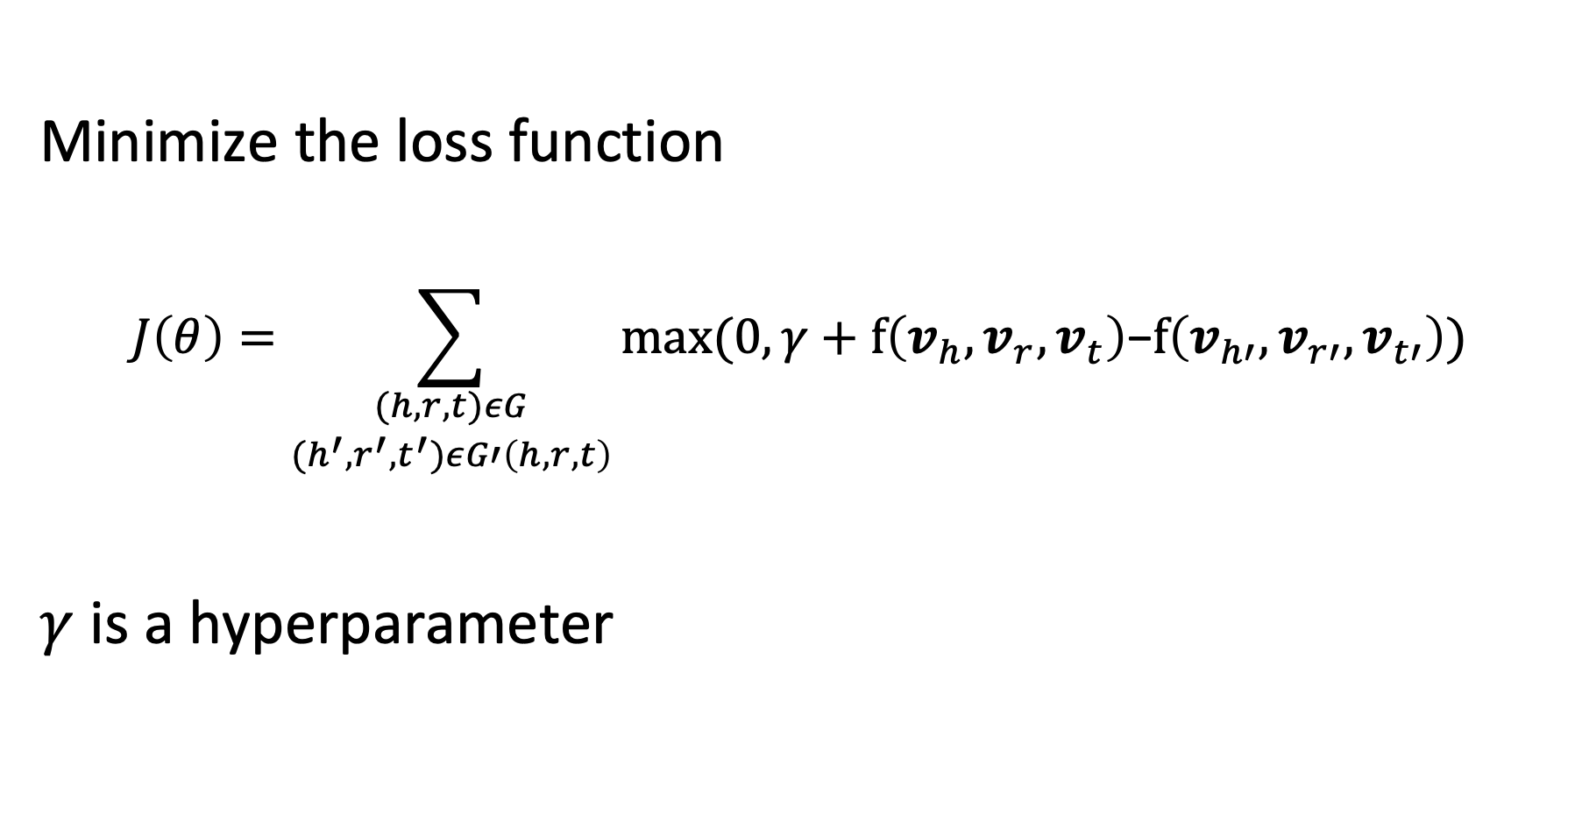
Learning the Model
Minimize the loss function
$$J\left(θ\right)=\sum_{\begin{aligned}(h,r,t)εG \\ (h^{′},r^{′},t^{′})εG′\left(h,r,t\right)\end{aligned}}{max⁡(0,γ+f\left(v_{h}, v_{r},v_{t}\right)\text{−}f\left(v_{h′}, v_{r′},v_{t′}\right))}$$
$γ$ is a hyperparameter
Notes:
Using the plausibility function, we can formulate a loss function that should be minimized. The minimization will be performed as usual using SGD.

Slide 44
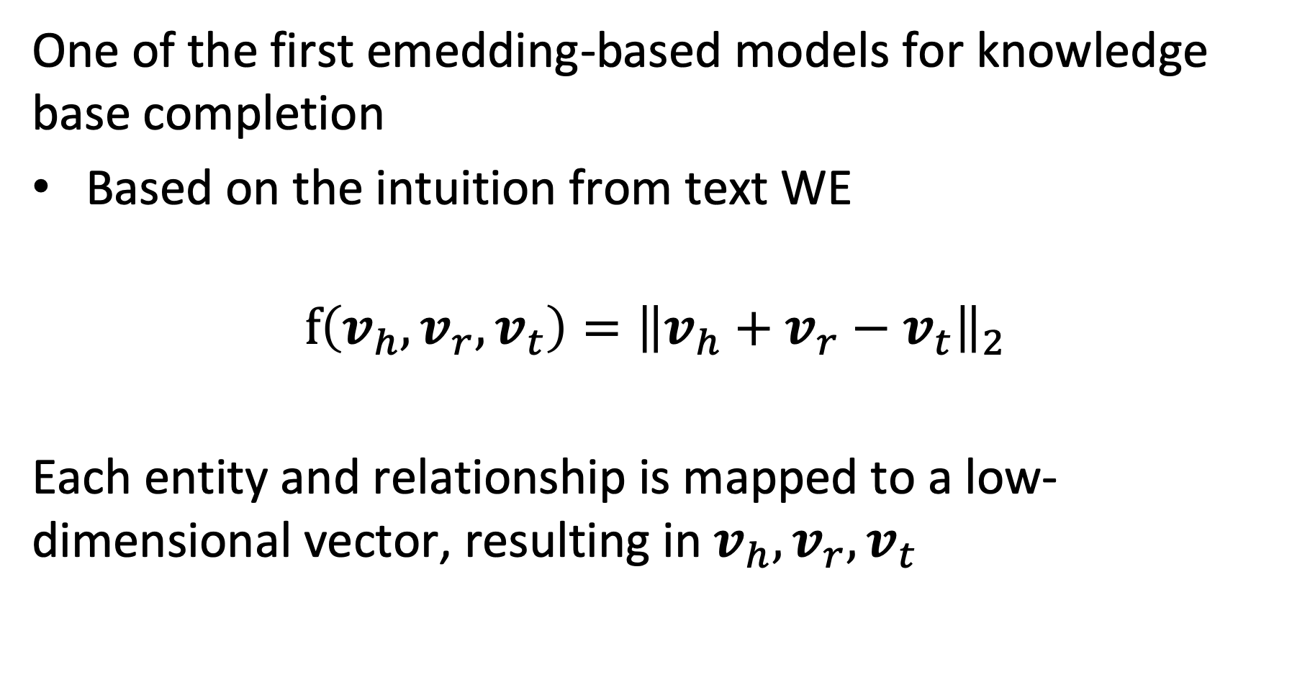
TransE Model
One of the first emedding-based models for knowledge base completion
Based on the intuition from text WE
$$f\left(v_{h}, v_{r},v_{t}\right)={\left\|v_{h}+v_{r}−v_{t}\right\|}_{2}$$
Each entity and relationship is mapped to a low-dimensional vector, resulting in $v_{h}, v_{r},v_{t}$
Notes:
With the generic model we can instantiate different concrete approaches for link prediction, depending on the choice of f. One of the initial approaches that was strongly inspired by our initial observation on word embeddings from the beginning. It directly introduces a vector $v_{r}$ that represents the linear transformation corresponding to a relationship, and mapping the head and tail into the same (low-dimensional) vector space.
The mappings from the entities and relationships to the latent space are performed (as in word embeddings) using embedding matrices, which constitute the model parameters that have to be learnt using SGD.

Slide 45
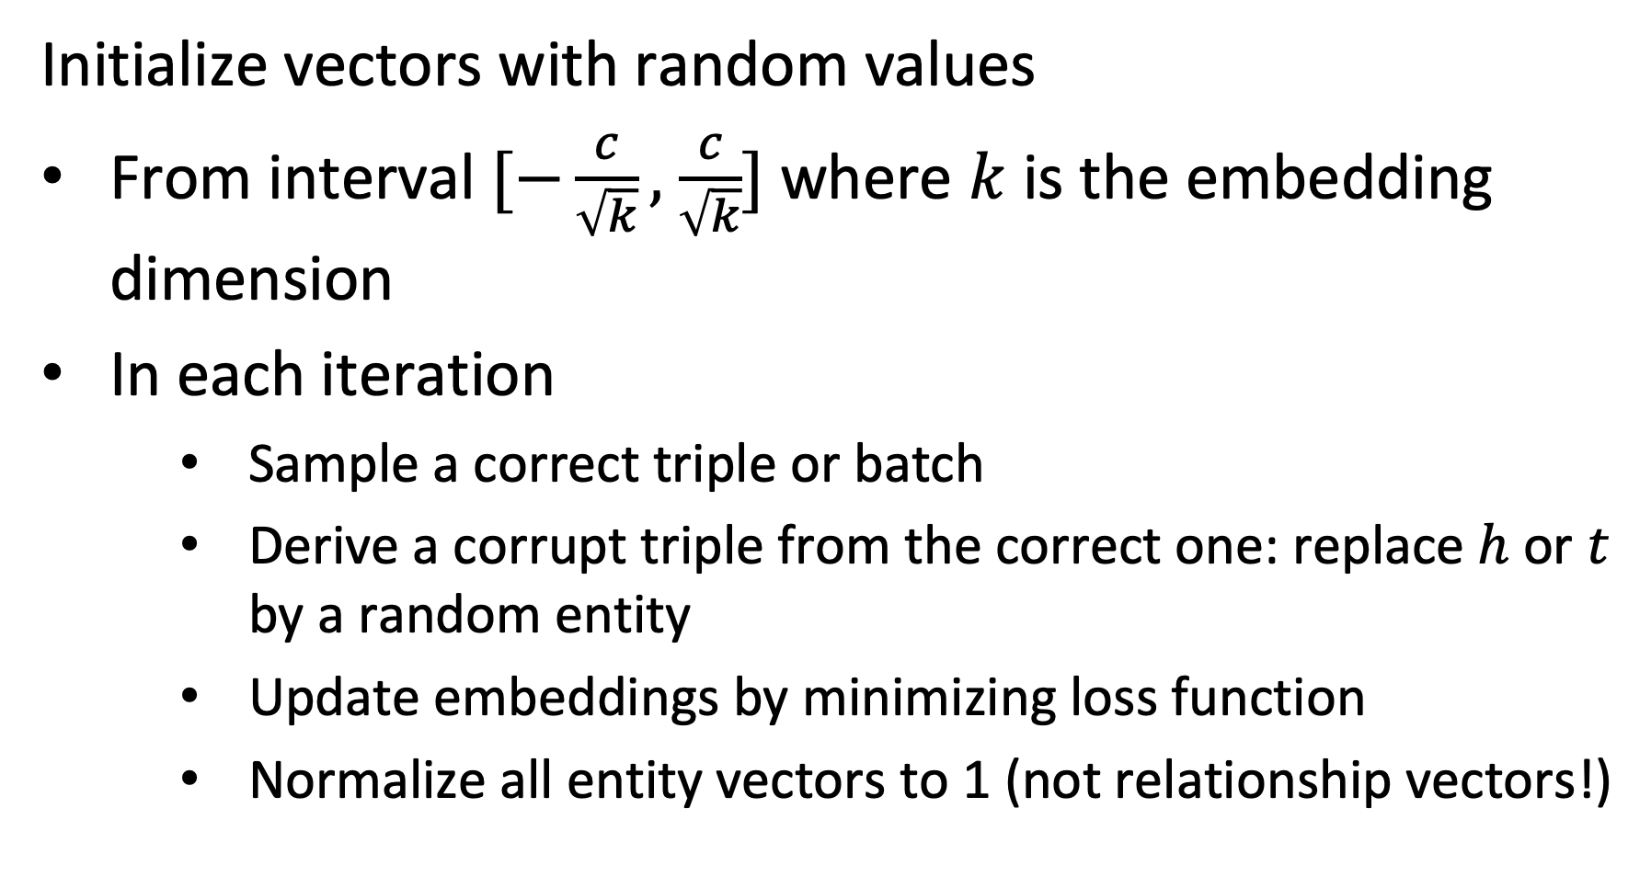
Performing SGD
Initialize vectors with random values
From interval $[−\frac{c}{\sqrt{k}},$ $\frac{c}{\sqrt{k}}]$ where $k$ is the embedding dimension
In each iteration
Sample a correct triple or batch
Derive a corrupt triple from the correct one: replace $h$ or $t$ by a random entity
Update embeddings by minimizing loss function
Normalize all entity vectors to 1 (not relationship vectors!)
Notes:
The SGD algorithm proceeds as follows. First the vectors are initialized with random values (the choice is motivated by empirical findings from neural network training. In the published paper c = 6). Then in every iteration a triple (or several triples are randomly chosen). Negative samples are generated by randomly replacing head or tail (not both). The update of the embeddings is performed as usual by computing the differential of the loss function. Entity vectors are normalized to 1 in every iteration (this avoids the model to find a trivial solution).

Slide 46
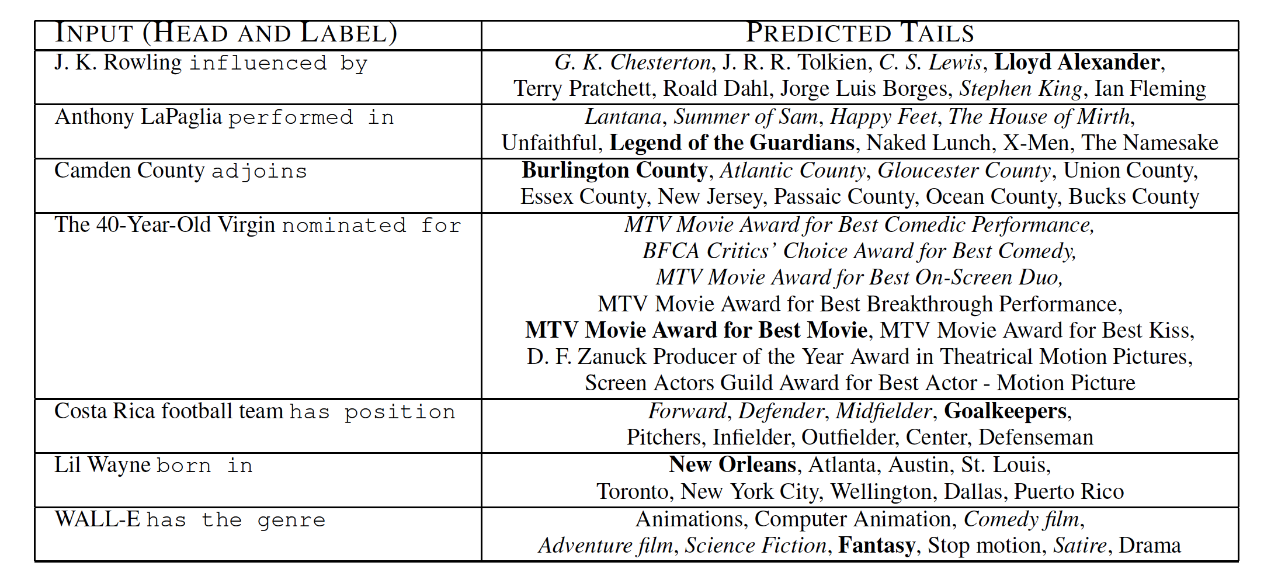
Qualitative Results
Notes:
The qualitative results show that the method works reasonably well. The bold phrases are the correct predections. However, given that the knowledge bases used for evaluation are incomplete, it is not out of question that also other predictions are meaningful.

Slide 47
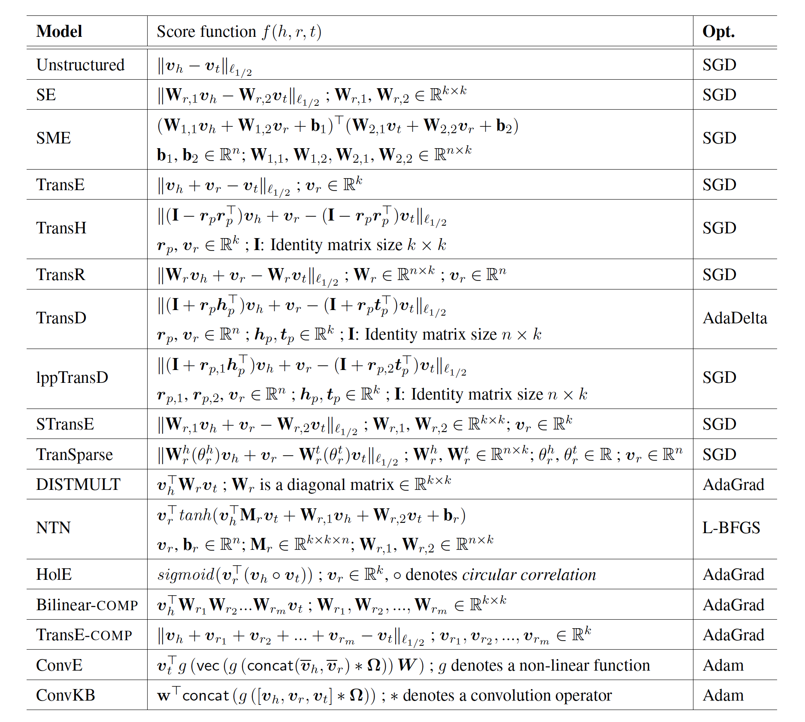
Alternative Models
Notes:
The TransE method is only one example of very many methods that have been in the meanwhile proposed to tackle the link prediction problem.

Slide 48
Which is true? The score function f(h,r,t) …
has always larger values for triples (h,r,t) that are part of the known knowledge graph than for other triples
maps triples to vectors in the embedding space
is always positive
is optimized by stochastic gradient descent

Slide 49
References
Course material based on
Pershina, Maria, Yifan He, and Ralph Grishman. "Personalized page rank for named entity disambiguation." Proceedings of the 2015 Conference of the North American Chapter of the Association for Computational Linguistics: Human Language Technologies. 2015.
Talukdar, Partha Pratim, and Koby Crammer. "New regularized algorithms for transductive learning." Joint European Conference on Machine Learning and Knowledge Discovery in Databases. Springer, Berlin, Heidelberg, 2009.
Bordes, Antoine, et al. "Translating embeddings for modeling multi-relational data." Advances in neural information processing systems. 2013.
Nguyen, Dat Quoc. "An overview of embedding models of entities and relationships for knowledge base completion." arXiv preprint arXiv:1703.08098 (2017).
Doan, AnHai, et al. "Learning to map between ontologies on the semantic web." Proceedings of the 11th international conference on World Wide Web. ACM, 2002.

Slide 50
Exam Date
Monday 24.01.2022 from 16h15 to 19h15
Your computer will be admitted to the exam
You will have Internet access
But: communication not allowed (messaging, social platform etc.)
You can use your notes (paper of electronically, all lecture materials)

Slide 51
Course Feedback - Suggestions
Lecture
For some too much content, too fast
Lack of structure on the slides
Prerecord videos and review materials
First weeks too abstract
Exercise
Sometimes hard, sometimes too easy
Mini-projects
Bugs in the code
Organisation
Upload videos faster
Library of quiz questions

Slide 52
Question
Would you think a 3+3 format would be more appropriate for the content covered in the course?

